Slide 1
TARANG GUPTA-13BCE0352
SCHOOL OF COMPUTER, SCIENCE
VELLORE INSTITUTE OF TECHNOLOGY, VELLORE, INDIA
PROF. DEGA NAGARAJU
Slot – C1
SUBJECT:-OPERATION RESEARCH (MEE437)

Slide 2
A study of Transportation Problem for an Essential Item of Southern Part of North Eastern Region of India as an OR Model and Use of Object Oriented Programming

Slide 3
What is transportation problem?

Slide 4
THE transportation problem is a special class of linear programming problem that deals with shipping a product from multiple origins to multiple destinations.
The objective of the transportation problem is to find a feasible way of transporting the shipments to meet demand of each destination that minimizes the total transportation cost while satisfying the supply and demand constrains.
Due to time-consuming computations of the simplex method ,the transportation method is preferred in solving transportation problems.
The two basic steps of the transportation method are:
Step 1. Determine the Initial basic feasible solution
Step 2. Obtain the optimal solution using the solution obtained from step 1.
That is, all the optimal solution approaches) in solving transportation problems need an IBFS to get the optimal solution.
Though, in the literature, many heuristic approaches were developed in getting an initial solution, such VAM - Vogel’s approximation method.

Slide 5
VAM is considered to be a better heuristic approach.
Five methods namely northwest corner method, minimum cost method, row minimum cost method, column minimum cost method and VAM were coded in C++
We found that the object oriented program of VAM given by for solving transportation problem is not well coded.
This is checked with many randomly generated problem instances and found that his coding worked for none.
In this paper the corrected coding of VAM in C++ is implemented.
Then its correctness is verified via many randomly generated instances

Slide 6
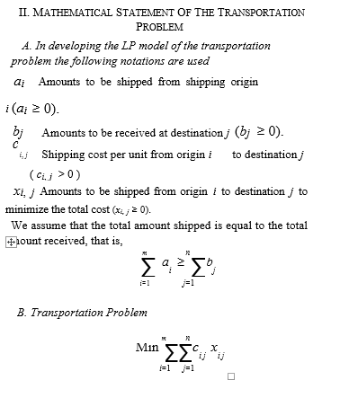

Slide 7
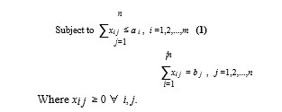

Slide 8
VOGEL’S APPROXIMATION METHOD (VAM)
The steps involved in VAM in producing the initial feasible solution are described below:
Step 0: Balance the given transportation problem if either (total supply > total demand) or (total supply < total demand).
Step 1: For each row and column of the transportation table, determine the difference between the least and the next least shipping costs.
Step 2: Select the row or column with the largest difference.
Step 3: Assign as many units as possible to the least cost square in the row or column selected.
Step 4: Eliminate any row or column that has completely been satisfied by the assignment just made.
Step 5: Recalculate the cost differences omitting rows or columns already crossed out in the preceding step.
Step 6: Move to step 2 and repeat the steps 2 – 5 until an initial feasible solution has been obtained.

Slide 9
The cost got after appllying the data by VAM is 12,73,000
The cost got after applying the optimal algorithm called MODI METHIOD is 12,46,000
The cost got applying after putting the in the VAM C++ code as input is 12,72,000 which is almost equal to solution got from

Slide 10
Thank you

